Slide 1

Twilio Tech Titans Presents: ToodleDo!
Judith Liem, Ricardo Salcido,
Afreen S Mohammed,Saleem Raes,
Mushfika Raisa
December 2021

Slide 2

What’s The Problem?
Have you ever lost track of time and forgot to do a task or attend a meeting?
Our app sends SMS notifications straight to your phone to remind you of tasks and meetings. Say Toodle-Oo to late meetings and forgotten tasks with ToodleDo!
As a user I need to create and view my tasks for the day.
As a user I need to input a title, description, time, and priority level for every task.
As a user I need SMS reminders so I’m never late for my meetings again!
More convenient than reminders confined to the browser or desktop

Slide 3
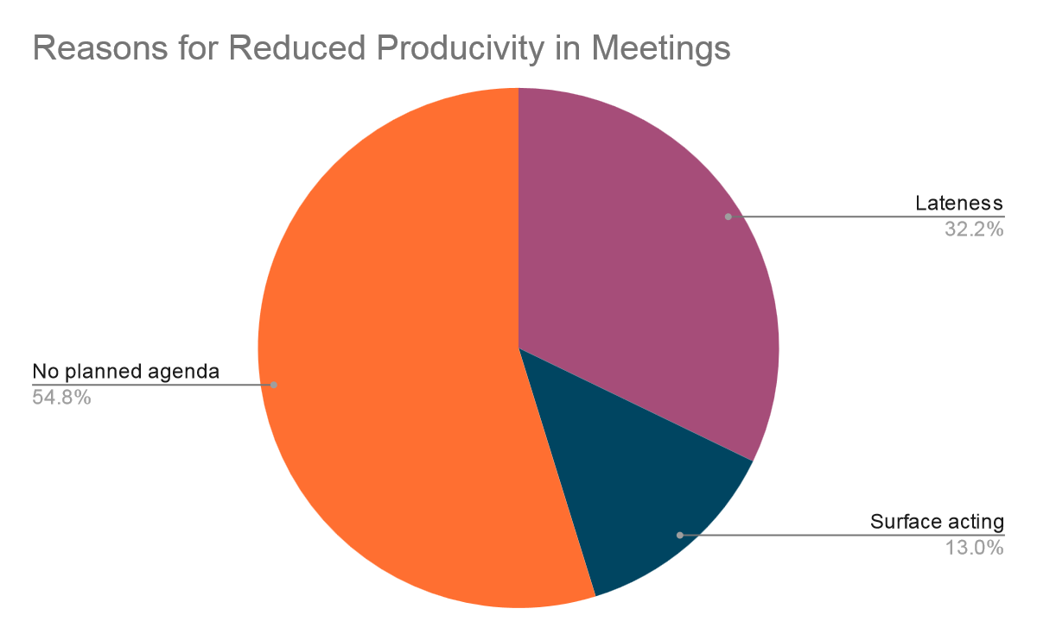
Cold Hard Facts
Approximately 11 million business meetings are held every day, and over 30% of those meetings start late.
Tardiness affects Business Bottom Lines
Late meetings cost 8% of the productivity of that meeting
Unproductive meetings cost US businesses approximately $37 billion annually (US Bureau of Labor Statistics)
To Do Lists have a calming effect on 73% of people
76% of US citizens currently keep at least 1 list
Source: https://www.swipedon.com/blog/how-to-minimize-the-damaging-effects-of-meetings-starting-late

Slide 4


You’ve Got A Notification!
Live Demo
Verizon confidential and proprietary. Unauthorized disclosure, reproduction or other use prohibited.
‹#›

Slide 5
Execution and Feasibility
Realistic and Viable.
With a bit more time, we could implement a proper delivery of ToodleDo!
Persist tasks to a backend database with MySQL
Currently ToodleDo has OAuth which allows 3rd party login
With this we can connect to a user’s Google or Outlook calendar
Target Users
Developers, Managers, Technicians
Anyone who is working on a project and needs to stay on task
Twilio
React
SpringBoot

Slide 6
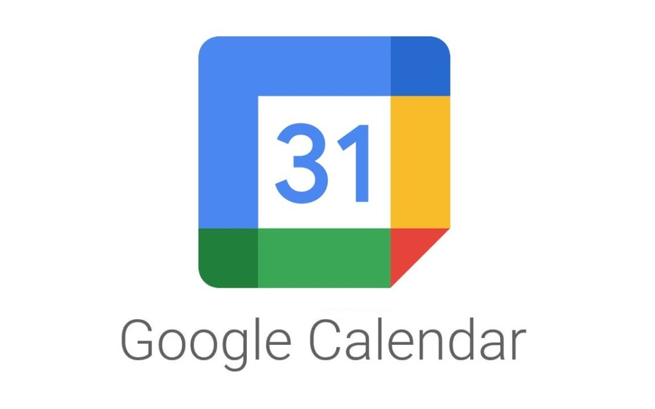


Next Steps
Google Calendar and Beyond
Automatically scan Google or Outlook Calendar every day for meeting times and send reminders without having to fill out a task form.
5G IOT Triggered Notifications
Verizon technicians on field calls can get notifications about test coverage as they move. Users in a MEC area can get notifications about their surroundings.
RSS Feed
Allow users to sign up for notifications about their favorite interests, sports, news, etc.

Slide 7
Innovation
IOT
A creative way to be notified about work meetings and tasks on your phone!
Solves a current issue that many VTeamers face
With emerging 5G IOT and MEC technologies, there’s endless possibilities for new ways to think about SMS notifications
Opportunities to benefit Verizon employees, customers, and beyond
5G
Twilio
ToodleDo
SMS
DevOps
MEC

Slide 8
Team Collaboration and Learnings
Daily Stand Ups
Kanban Board
Focus on MVP
Since the Hackathon was only 2 days, our team relied a lot on constant communication in order to make sure things were working and that the project was moving forward.
Before starting to work on our project, it was extremely helpful to write out all of our tasks and take advantage of Github’s Kanban Board Project tab. Throughout the project we referenced this board to make sure we were on track.
When discussing what piece to work on next, we would have a group discussion and prioritize on hitting that Minimum Viable Product.
Collaborative Decisions
Asking For Help
Improvements?
Our team spent a lot of time listening to each other and allowing everyone a chance to speak. We took into consideration people’s different abilities and strengths and split up work accordingly as best we could.
Whenever we hit a blocker, after working on it for a while by ourselves, one of us would recommending pinging Stephen, Ralph, Akanksha, Mariah, or Kristen. We are extremely grateful for our mentors’ commitment and dedication to our team’s success.
Overestimated some implementation of the code, enabling CORS for Springboot took a lot longer than we thought it would. We could have done better at divide and conquering different aspects of the project.

Slide 10
Toodle-Oo!
Thank you for your consideration
This has been a Twilio Tech Titans presentation

